Slide 1
End to End Process Map for Ranging Controls & Space
New Merchandising Plan

Slide 2
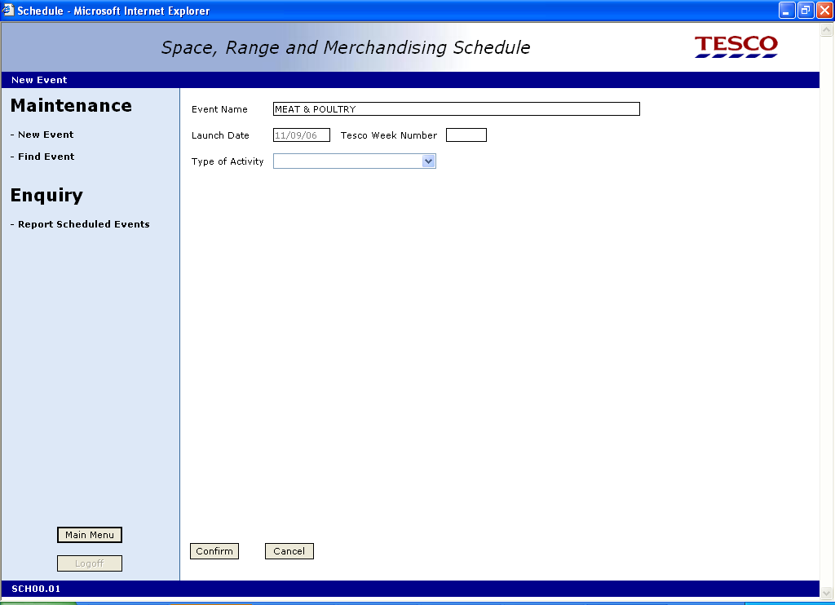
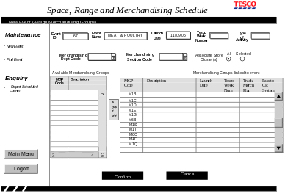
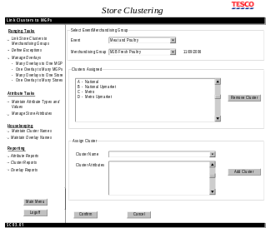
Natural Work Team
Set -Up Product Hierarchy and Ranging Clusters
Make any changes to existing supplementary parent links
Prep/analysis for event (all areas)
Set up any new Ranging attribute types and values e.g price sensitive
Create any new Merchandising Groups
Make any changes to the details of Merchandising Group e.g. description, reserved indicators, fixed/matched settings
Add Planning Group Event to the Schedule
Natural Work Team meet
Add any new Merchandising Group Ranging Events to the Planning Group Event
Make any changes to the clusters for the Merchandising Groups
Create any new Main to Supplementary links
Brief for the Event includes all Range Ops and Space objectives e.g. Merchandising Group changes & forecasts of space splits
Link any new overlays for the Merchandising Groups
Make all changes to Subgroup links
Set the end date for any redundant Merchandising Groups
Key
Schedule
Merchandising Group Maintenance
Pre-Ranging
Equipment Matrix
Planned Space & Authorisation
Supported Plans & Ranges Matrix

Slide 3
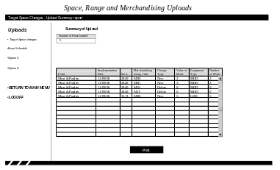
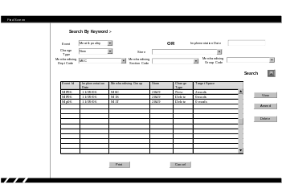
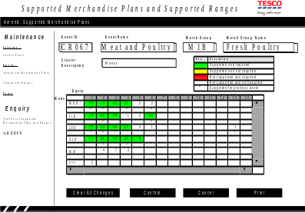
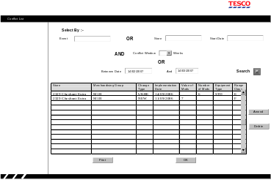
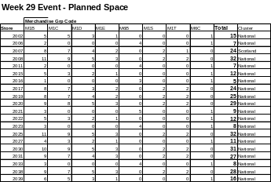
Plan Space Changes for Stores
Build Supported Merchandise Plans and
Target Space - Maintain MG Authorisation
Review
Summarise the change as a matrix (cluster by mods)
Future dated Range to Space Calculation made
Upload future dated Store specific planned space changes for Merchandising Groups, including ‘0’ space for deleted Merchandising Groups & manage Main to Supplementary links
Make changes to store/
Merchandising Group cluster exceptions
Communicate to Space Team Pre-ranging complete
Manage/
maintain Equipment for Event
Identify split by Equipment Type & No. of Stores
Allocate range classes and finalise space matrix
Manage store exceptions
Manage UKBE space conflicts
Define store specific space changes (out of scope)

Slide 4
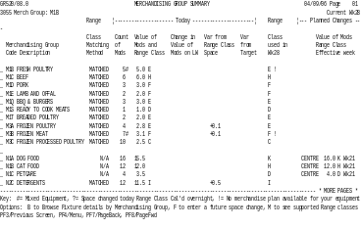
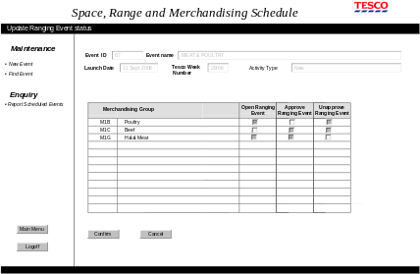
and Ranges Matrix
Build Merchandise Plans and Ranges
Check Space Recommendations with Stores
Store Feedback
6/-5 Review impact report verificed and sign-off with NWT
-6
Make planned changes and matrix visible to store
(update GR)
-6/-5
Store review planned space change and agree/
challenge
-16 to -6
Merchandising Plans and Ranges built
Review impact report
(wk -18).
Sign off with NWT
Approve Ranging Event on Schedule
-4
Store confirms future dated planned space and records location
Acceptance by
Store?
Yes
No
-5/-4
Centre & Store negotiate planned space change and upload any changes

Slide 5
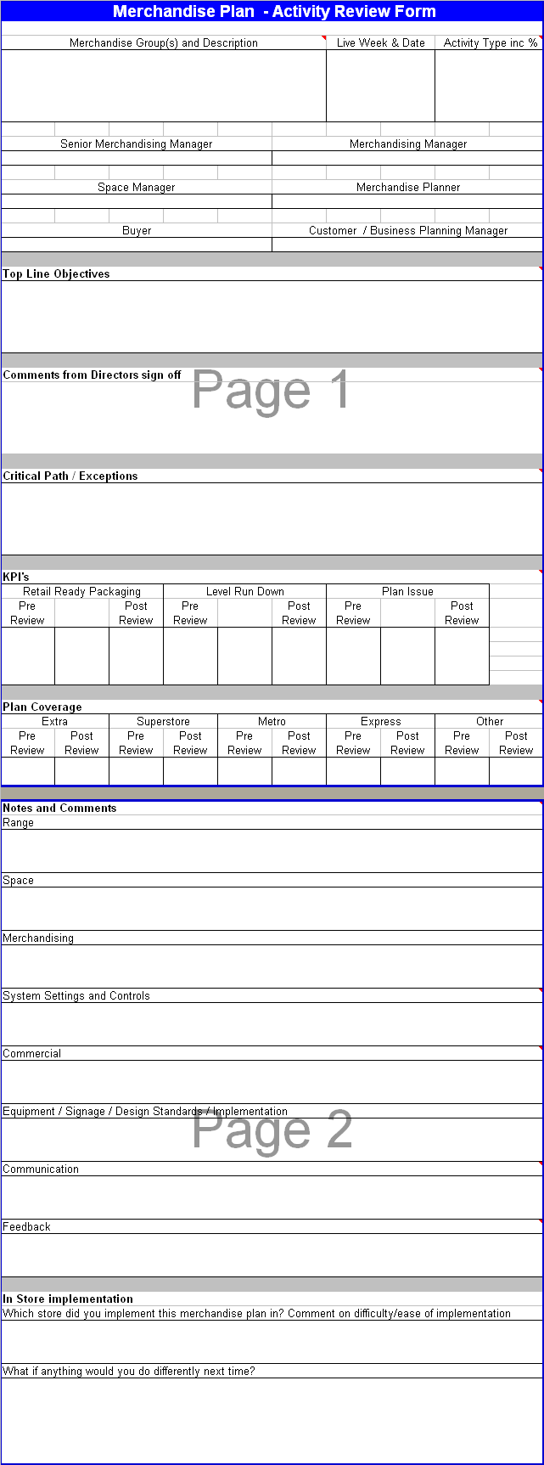
Implementation
Review
-4
Final Range Class calculated communicated to Retail Range Tools
-3
Store review Retail Range reports
-2
Plans cascaded within centre
-1
Merchandising plans issued based on future planned space
0
Stores merchandise area and product map
Review objectives against Store and Centre activity

